Slide 1

Sardar Vallabhbhai National Institute of Technology, Surat
2024 - 2025
Detecting Fraudulent Reviews Using Machine Learning
Under the Guidance of:
Dr. Krupa N. Jariwala
Asst. Professor
DoCSE
Prepared by:
Aditi Das
(P23DS008)
13th December, 2024

Slide 2

Contents
Introduction
Motivation & Objectives
Literature Review
Implementation Methodology
Experiment Details
Result & Analysis
Conclusion & Future Work
References

Slide 3
Introduction
Fake reviews impact consumer decisions and harm business credibility.
Their prevalence has grown with the rise of e-commerce platforms.
Manual review moderation is time-consuming and inefficient at scale.
Machine learning offers advanced, automated solutions for detection.
The challenge lies in differentiating fake reviews from genuine ones in high-dimensional, noisy data.
A robust detection system enhances consumer trust and ensures fair practices.

Slide 4
Motivation & objectives
Motivation:
Trust in online platforms is eroded by fake reviews.
Current systems often lack accuracy and scalability.
Identifying fake reviews can protect consumers and promote fair practices.
Objectives:
Develop machine learning pipelines for fake review detection.
Evaluate and compare the performance of classifiers.
Random Forest
Support Vector Classifier (SVC)
Logistic Regression
Identify the best-performing pipeline.
Explore future improvements in preprocessing and feature extraction.

Slide 5
Literature Review
Insights:
Types of Fake Reviews: Promotional reviews inflate product value, while negative reviews harm competitors. These distort market competition and erode consumer trust.
Methodologies:
Machine learning models like SVM, Random Forest, Logistic Regression, and deep learning models such as CNNs and LSTMs are widely used.
Supervised models rely on labeled data, while unsupervised and semi-supervised approaches address limited labeled data challenges.
Scalable methods like SGD optimize classification through iterative learning.

Slide 6
Literature Review
Insights:
NLP Techniques:
Text features are extracted using TF-IDF, n-grams, and embeddings.
Preprocessing includes tokenization, stop word removal, and stemming for noise reduction.
Advanced NLP models like BERT and Longformer improve contextual understanding and accuracy.
Behavior Analysis:
Examines review frequency, redundancy, sentiment intensity, and timestamps for anomalies.
CNNs enhance detection by modeling behavioral data dependencies.

Slide 7
Literature Review
Authors | Dataset Used | Methods | Contribution | Disadvantages | Remarks
Balakrishnan et al. [1] | Fake reviews dataset by Joni Salminen (CC-By Attribution 4.0 International) | SGD, RF, SVM, KNN | Achieved 86.7% accuracy in fake review detection using SGD, surpassing RF, SVM, and KNN | Limited to the dataset used; may not generalize well to other datasets | Further testing and validation needed for real-world application
Shunxiang et al. [2] | Ott, YelpChi, YelpZIP | Sentiment Intensity and PU Learning (SIPUL) | Proposed a model that continuously learns from streaming data to detect deceptive fake reviews | Requires continuous training data updates, increasing time cost due to the sentiment division step | Effective in detecting fake reviews in large datasets, though performance may decline with data overload

Slide 8
Literature review
Authors | Dataset Used | Methods | Contribution | Disadvantages | Remarks
Devika et al. [3] | Not specified | NLP, Sentiment Analysis, TF-IDF, Naive Bayes, SVM | Proposed a framework combining NLP and sentiment analysis for fake review detection | Manual data labeling is Resource intensive, with uncertain credibility of labeled data | Proposed system can filter fake reviews and separate spammers from non spammers
Thilagavathy et al. [4] | Reviews of 20 Hotels in Chicago hotel dataset | Naive Bayes, Support Vector Machine, TF-IDF Vectorizer | Developed a model to detect fake reviews using machine learning and NLP techniques | Limited dataset used for training, which may affect accuracy | The model can be expanded for greater accuracy and authenticity in reviews

Slide 9
Literature review
Authors | Dataset Used | Methods | Contribution | Disadvantages | Remarks
Dinesh et al. [5] | Product review datasets from ecommerce sites | SVM, Naive Bayes, Backpropagation, POS tagging, Stemming, Lexicon-based approach | Proposed a framework for opinion mining using NLP techniques, integrated spam detection module | High complexity and time consuming spam detection | The system helps in analyzing customer feedback and detecting fake reviews
Dhamdhere et al. [6] | Amazon reviews | Support Vector Machine (SVM) | Developed a system to detect fake reviews on Amazon using SVM, achieving 80% accuracy | Limited to Amazon dataset; may not generalize to other platforms | Focuses on both polarity ratings and classifiers for fake review identification

Slide 10
Literature review
Authors | Dataset Used | Methods | Contribution | Disadvantages | Remarks
Biruntha et al. [7] | Twitter API, Amazon, eBay | Naive Bayes, Maximum Entropy, SVM, Unsupervised Dictionary based Approach | Demonstrated sentiment analysis using various NLP tools, proposed a system for detecting fake reviews | Limited by the quality of the dataset, potential for misclassification | Focus on improving sentiment analysis accuracy and detecting fake reviews
Elmogy et al. [8] | Yelp dataset of restaurant reviews | KNN, Naive Bayes, SVM, Logistic Regression, Random Forest | Proposed an ML approach combining textual and behavioral features for fake review detection, with KNN (K=7) achieving an 82.40% f-score | The study is limited to the Yelp dataset and may not generalize to other datasets | The inclusion of behavioral features increased the f-score by 3.80%

Slide 11
Literature review
Authors | Dataset Used | Methods | Contribution | Disadvantages | Remarks
Zhang et al. [9] | Yelp | Behavior sensitive feature extractor, Context-aware attention mechanism | Proposed an end-to-end framework integrating behavioral and textual features, achieving state-of-the-art results in fake reviewer detection | Requires extensive computational resources | Significant step towards automated fake reviewer detection, reducing human labor costs
Ozbay and Alatas [10] | BuzzFeed Political News, Random Political News, ISOT Fake News | BayesNet, JRip, OneR, Decision Stump, ZeroR, SGD, CVPS, RFC, LMT, LWL, CvC, WIHW, Ridor, MLP, OLM, SimpleCart, ASC, J48, SMO, Bagging, Decision Tree, IBk, KLR. | Proposed a two-step method combining text mining and supervised AI for fake news detection, evaluating 23 algorithms across three datasets. | Limited to the datasets used; may not generalize to other datasets | The Decision Tree algorithm showed the best performance in terms of accuracy, precision, and F-measure

Slide 12
Literature review
Authors | Dataset Used | Methods | Contribution | Disadvantages | Remarks
Singh and Tanwar [11] | Home appliances review dataset | Random Forest, Support Vector Classifier, Logistic Regression | Developed a model to identify fake reviews using sentiment ratings and n-grams | Requires substantial labeled data for training | The proposed methods performed better in terms of accuracy compared to previous studies
Table 1: Comparison of Different Methodologies

Slide 13
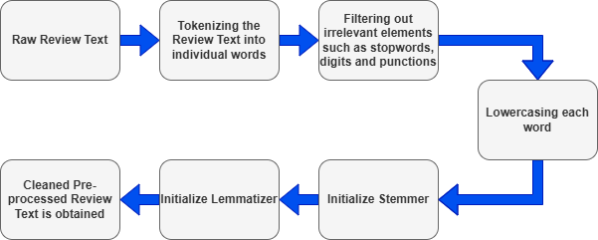
Implementation methodology
Dataset Pre-processing:
Tokenization, removal of irrelevant elements (digits and punctuation) and stop words.
Lowercasing, stemming, lemmatization.
Fig 1: Flowchart of Preprocessing Raw Review Text

Slide 14
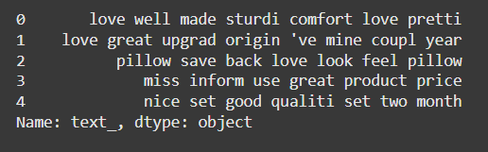
Implementation methodology
1. Dataset Pre-processing:
Fig 2: Final Preprocessed Text

Slide 15
Implementation methodology
2. Feature Extraction
Countvectorizer : Converts text into a sparse matrix of token counts.
TF-IDF : Weighs token importance across the dataset.
Example:
the product is great
great product indeed
great | indeed | is | product | the
1 | 0 | 1 | 1 | 1
1 | 1 | 0 | 1 | 0
great | indeed | is | product | the
0.41 | 0.00 | 0.58 | 0.41 | 0.58
0.50 | 0.70 | 0.00 | 0.50 | 0.00
Table 2: Count Vectorization Matrix
Table 3: TF-IDF Matrix

Slide 16
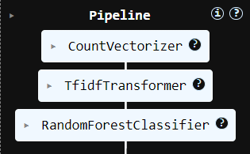
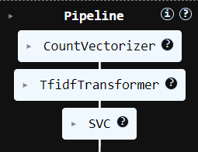
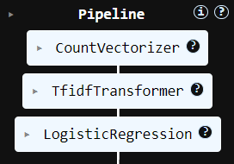
Implementation methodology
3. Model Training:
Pipelines:
Random Forest
Support Vector Classifier
Logistic Regression
Input: Pre-processed dataset with extracted features.
Output: Classification of reviews as fake or genuine.
Fig 3: Random Forest Pipeline
Fig 4: SVC Pipeline
Fig 5: Logistic Regression Pipeline

Slide 17
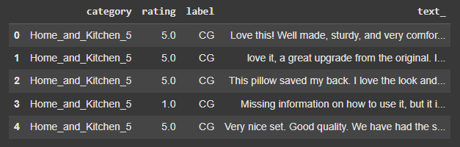
Experiment details
Dataset Used
Dataset Name: Home Appliances Review Dataset
Records: 40,431 reviews
Attributes:
category: Type of appliance reviewed.
rating: Numerical score indicating user satisfaction.
label: Fake or genuine review.
text_: Review content.
Data Split:
Training: 75%
Testing: 25%
Fig 6: Sample of Home Appliances Review Dataset

Slide 18
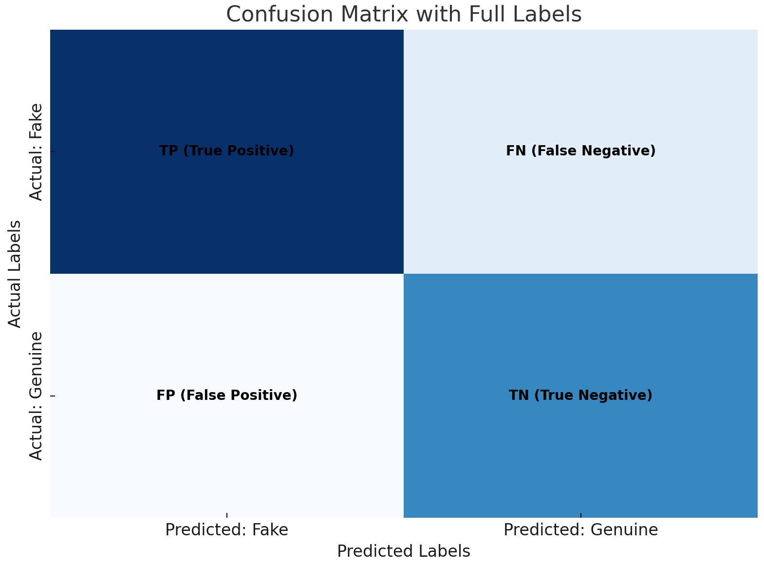
Experiment details
Evaluation Parameter
Accuracy: Percentage of correctly classified reviews.
Precision: Proportion of true positives among predicted positives.
Recall: Proportion of true positives among actual positives.
F1- Score: Harmonic mean of Precision and Recall.
Metric | Formula
Accuracy | (TP + TN) / (TP + TN + FP + FN)
Precision | TP / (TP + FP)
Recall | TP / (TP + FN)
F1-Score | 2 x (Precision x Recall) / (Precision + Recall)
Table 4: Formulas of Each Metric
Fig 7: Confusion Matrix

Slide 19
Result & analysis
Accuracy Comparison:
Random Forest: 84.35%
SVC: 88.26% (Best performing model)
Logistic Regression: 86.66%
Reasons for Performance:
SVC excels in high-dimensional spaces with optimal hyperplanes.
Random Forest struggles with sparse text data due to overfitting tendencies.
Logistic Regression handles linear relationships well but lacks on non-linear adaptability.
Model | Accuracy | Precision | Recall | F1-Score
Random Forest Classifier | 84.35% | 0.85 | 0.84 | 0.84
Support Vector Classifier | 88.26% | 0.88 | 0.88 | 0.88
Logistic Regression | 86.66% | 0.87 | 0.87 | 0.87
Table 5: Model Performance Comparison

Slide 20
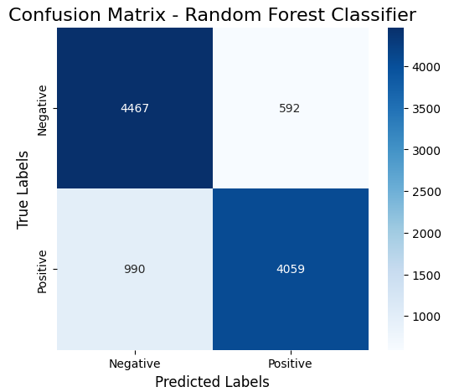
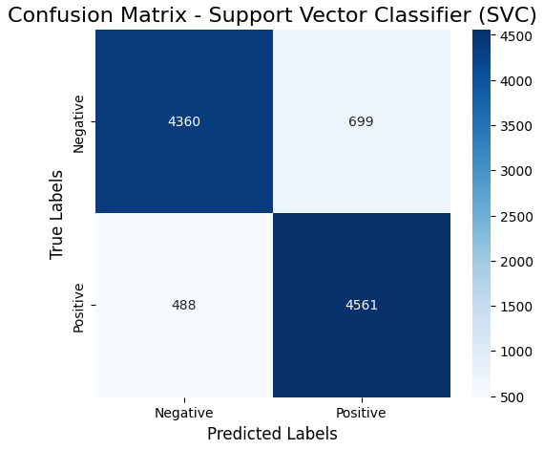
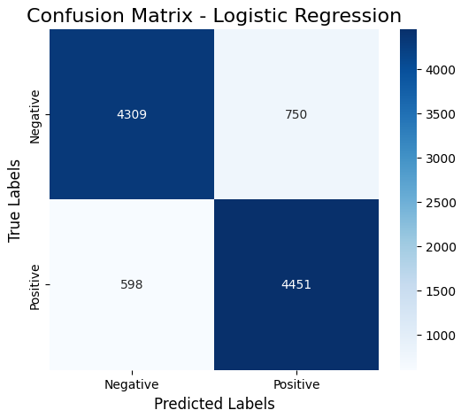
Result & analysis
Confusion matrix of 3 classifiers:
Fig 8: Confusion Matrix of Random Forest Classifier
Fig 9: Confusion Matrix of Support Vector Classifier
Fig 10: Confusion Matrix of Logistic Regressor

Slide 21
Conclusion & Future Work
Conclusion:
SVC emerged as the best model for fake review detection, achieving the highest accuracy (88.26%).
Pre-processing techniques and TF-IDF significantly improved model performance.
The study highlights the effectiveness of machine learning pipelines in handling text-based classification tasks.
Future Work:
Incorporate advanced embeddings such as BERT to capture deeper contextual and semantic relationships in text.
Use deep learning techniques, such as Long Short-Term Memory (LSTM) networks or transformers, for enhanced sequential and contextual analysis.
Explore multisourced data curation to reduce biases and improve model generalizability.
Apply hyperparameter optimization techniques like GridSearchCV or AutoML for fine-tuning model performance.

Slide 22
references
[1] N. Balakrishnan, S. Chandru, T. Priyadharshini et al., “Decoding authenticity in online review using machine learning,” in 2024 International Conference on Cognitive Robotics and Intelligent Systems (ICC-ROBINS). IEEE, 2024, pp. 421–424.
[2] Z. Shunxiang, Z. Aoqiang, Z. Guangli, W. Zhongliang, and L. KuanChing, “Building fake review detection model based on sentiment intensity and pu learning,” IEEE Transactions on Neural Networks and Learning Systems, vol. 34, no. 10, pp. 6926–6939, 2023.
[3] P. Devika, A. Veena, E. Srilakshmi, A. R. Reddy, and E. Praveen, “Detection of fake reviews using nlp &sentiment analysis,” in 2021 6th International Conference on Communication and Electronics Systems (ICCES). IEEE, 2021, pp. 1534–1537.
[4] A. Thilagavathy, P. Therasa, J. J. Jasmine, M. Sneha, R. S. Lakshmi, and S. Yuvanthika, “Fake product review detection and elimination using opinion mining,” in 2023 World Conference on Communication & Computing (WCONF). IEEE, 2023, pp. 1–5.
[5] L. Dinesh, G. Kaviya, N. Kavya, A. Kousalya, and N. Lavanya, “Product reviews on opinion mining using nlp techniques,” in 2022 7th International Conference on Communication and Electronics Systems (ICCES). IEEE, 2022, pp. 952–957.

Slide 23
references
[6] O. Dhamdhere, A. Dhanwate, A. Kumbhar, and M. Singh, “Amazon’s fake review detection using support vector machine.”
[7] S. Biruntha, B. Ashwin, K. Padmasankar et al., “Distinguishing reviews through sentiment analysis using machine learning techniques,” in 2022 8th International Conference on Advanced Computing and Communication Systems (ICACCS), vol. 1. IEEE, 2022, pp. 1713–1719.
[8] A. M. Elmogy, U. Tariq, M. Ammar, and A. Ibrahim, “Fake reviews detection using supervised machine learning,” International Journal of Advanced Computer Science and Applications, vol. 12, no. 1, 2021.
[9] D. Zhang, W. Li, B. Niu, and C. Wu, “A deep learning approach for detecting fake reviewers: Exploiting reviewing behavior and textual information,” Decision Support Systems, vol. 166, p. 113911, 2023.
[10] F. A. Ozbay and B. Alatas, “Fake news detection within online social media using supervised artificial intelligence algorithms,” Physica A: statistical mechanics and its applications, vol. 540, p. 123174, 2020.
[11] C. Singh and S. Tanwar, “Fake review identification using machine learning,” in 2024 International Conference on Communication, Computer Sciences and Engineering (IC3SE). IEEE, 2024, pp. 582–587.

Slide 24
Thank You

